Slide 1
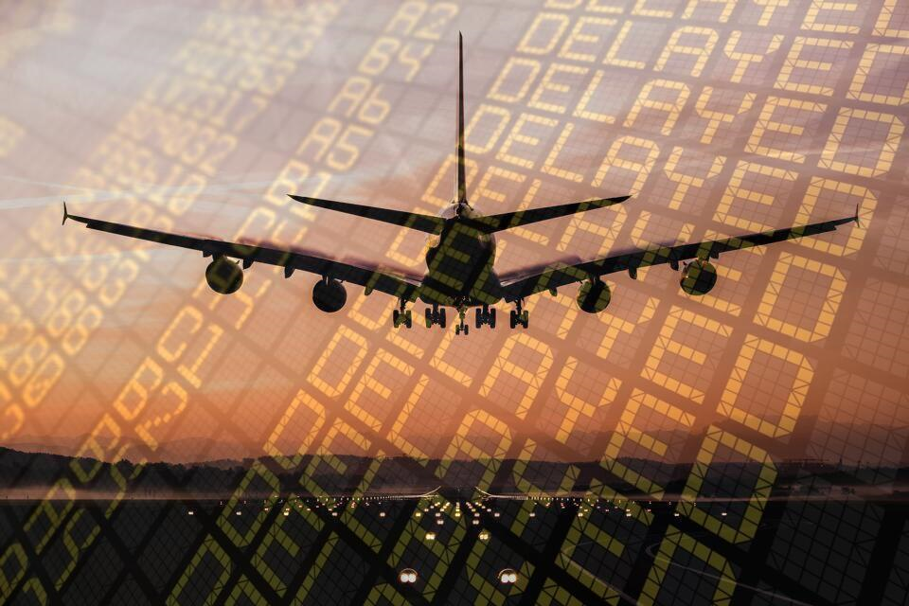
Predicting flight delay

Slide 2
Problem statement
Is there any impact due to flight delays? Flight delays not only cause inconvenience to passengers, but also cost the carriers billions of dollars. Flight delays can be caused due to bad weather conditions, airport congestion, airspace congestion, maintenance or security issues. These delays tarnish airlines on-time reputation, often resulting in loss of demand by passengers.
Looking at statistics compiled by the Bureau of Transport Statistics, the extreme weather causes only 5% delay of total delay minutes whereas the biggest contributors to delay have consistently been late arrival of aircraft and air carrier delay. In the light of the above statistics there is a need for an intelligent and automated prediction system that can predict possible airline delays. If we can model these delays accurately, we can account for most of the delayed flights per year.
Is there any impact due to flight delays? Flight delays not only cause inconvenience to passengers, but also cost the carriers billions of dollars. Flight delays can be caused due to bad weather conditions, airport congestion, airspace congestion, maintenance or security issues. These delays tarnish airlines on-time reputation, often resulting in loss of demand by passengers.
Looking at statistics compiled by the Bureau of Transport Statistics, the extreme weather causes only 5% delay of total delay minutes whereas the biggest contributors to delay have consistently been late arrival of aircraft and air carrier delay. In the light of the above statistics there is a need for an intelligent and automated prediction system that can predict possible airline delays. If we can model these delays accurately, we can account for most of the delayed flights per year.
The goal of this project is to predict whether a flight will be delayed, by utilizing the public dataset provided by Bureau of Transport Statistics, on local flights in United States for the year 2019.
DATA SOURCE: Data for the Capstone project is gathered from Bureau of Transportation website. Data gathered for 12 months from January to December for the year 2019. Dataset contains 7422037 rows and 78 columns.
https://www.transtats.bts.gov/DL_SelectFields.asp?gnoyr_VQ=FGJ&QO_fu146_anzr=b0-gvzr.

Slide 3
Data wrangling and exploration
Is there any impact due to flight delays? Flight delays not only cause inconvenience to passengers, but also cost the carriers billions of dollars. Flight delays can be caused due to bad weather conditions, airport congestion, airspace congestion, maintenance or security issues. These delays tarnish airlines on-time reputation, often resulting in loss of demand by passengers.
Looking at statistics compiled by the Bureau of Transport Statistics, the extreme weather causes only 5% delay of total delay minutes whereas the biggest contributors to delay have consistently been late arrival of aircraft and air carrier delay. In the light of the above statistics there is a need for an intelligent and automated prediction system that can predict possible airline delays. If we can model these delays accurately, we can account for most of the delayed flights per year.
Any irrelevant data was removed
Columns containing only redundant data
Row containing null values
Prepared features for data exploration
Converting dates to date time
As part of exploring data, visualized Distributions of % delayed flights by CARRIER, ORIGIN, MONTH, DAY OF WEEK. Visualized Distributions of single features like Departure Delay, DISTANCE, AIR TIME, FLIGHT DURATION.
Visualized correlations and dropped columns that were highly correlated.

Slide 4
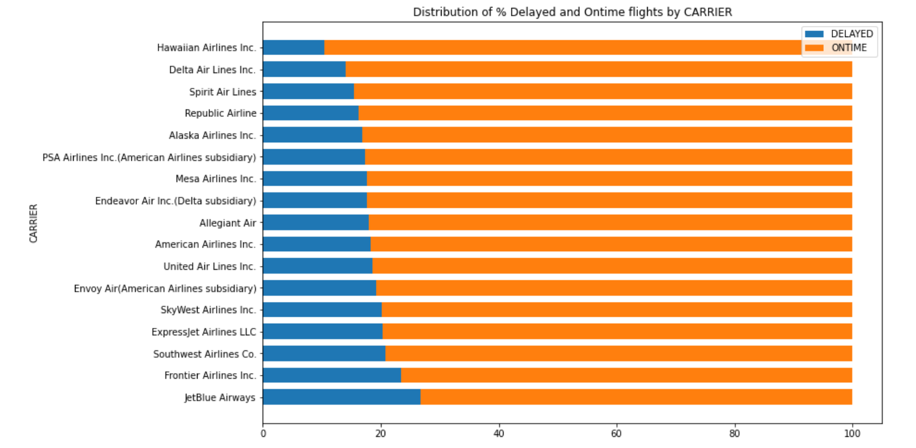
Data exploration - Findings
Is there any impact due to flight delays? Flight delays not only cause inconvenience to passengers, but also cost the carriers billions of dollars. Flight delays can be caused due to bad weather conditions, airport congestion, airspace congestion, maintenance or security issues. These delays tarnish airlines on-time reputation, often resulting in loss of demand by passengers.
Looking at statistics compiled by the Bureau of Transport Statistics, the extreme weather causes only 5% delay of total delay minutes whereas the biggest contributors to delay have consistently been late arrival of aircraft and air carrier delay. In the light of the above statistics there is a need for an intelligent and automated prediction system that can predict possible airline delays. If we can model these delays accurately, we can account for most of the delayed flights per year.
Airlines Frontier, Jet Blue have most % delayed flights when compared to Hawaiian Airlines, Delta Airlines which have least % delayed flights. Carrier can be considered as an important feature

Slide 5
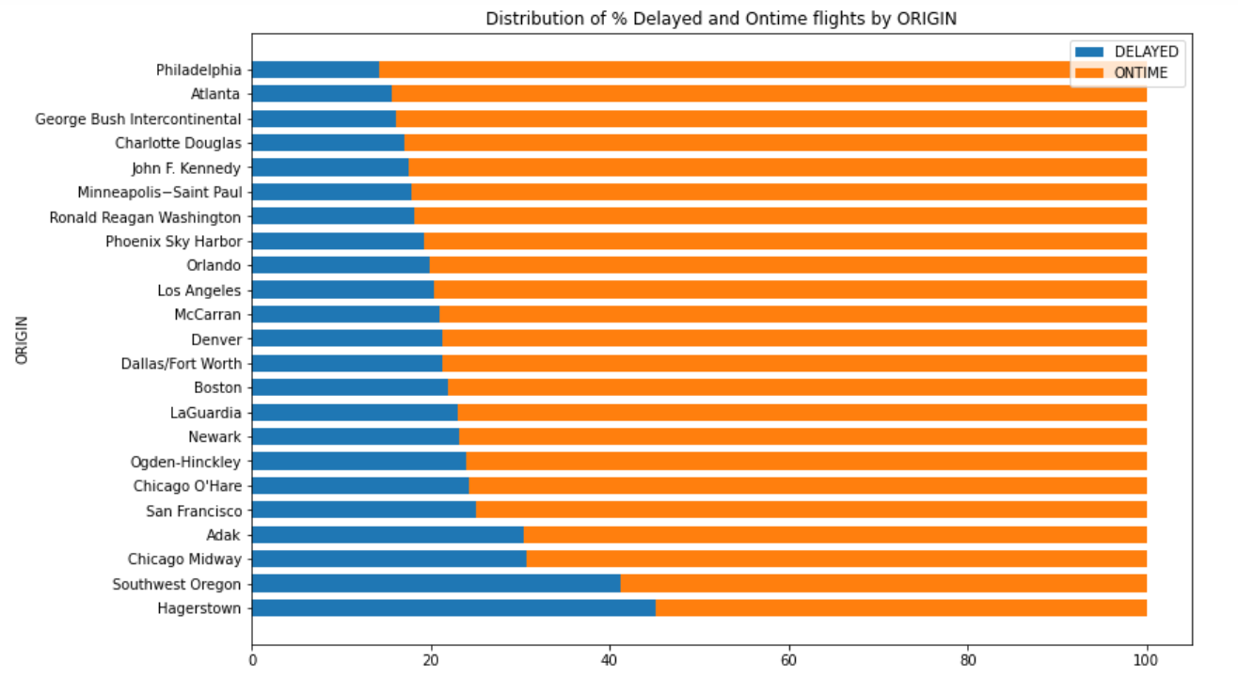
Data exploration - Findings
Airports Chicago Midaway, Newark have more % delayed flights when compared to Minneapolis, Atlanta which have least % delayed flights. Origin can be considered as an impotant feature
Flights originating from Hagerstown, Southwest Oregon have more % delayed flights when compared to Minneapolis, Atlanta which have least % delayed flights. Origin can be considered as an important feature

Slide 6
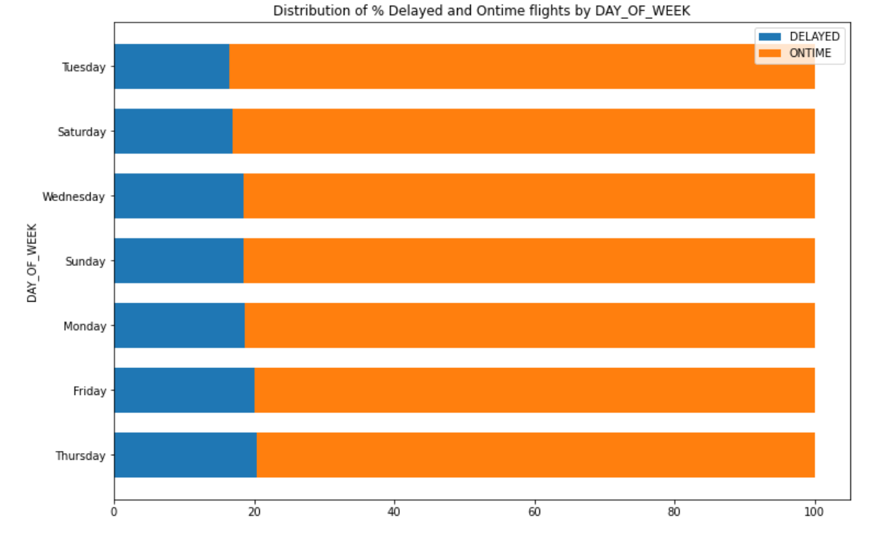
Data exploration - Findings
Airports Chicago Midaway, Newark have more % delayed flights when compared to Minneapolis, Atlanta which have least % delayed flights. Origin can be considered as an impotant feature
Flights on Thursday and Friday have more % delayed flights when compared to others days of week which have least % delayed flights. DAY OF WEEK can be considered as an important feature.

Slide 7
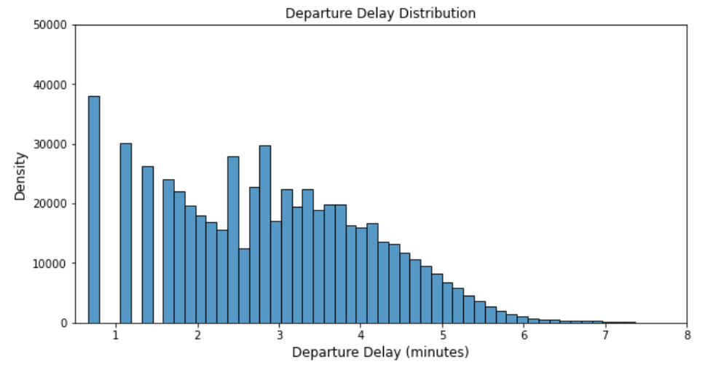
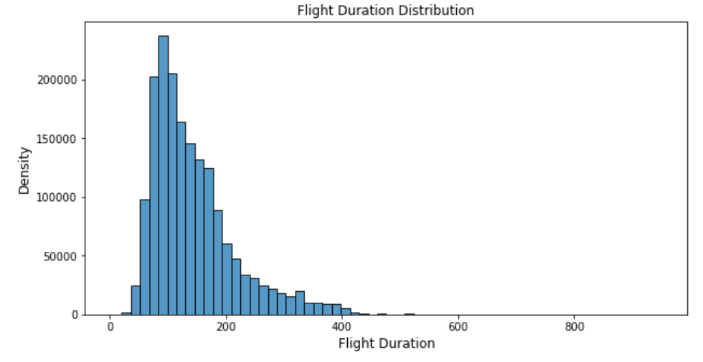
Data exploration - Findings
Airports Chicago Midaway, Newark have more % delayed flights when compared to Minneapolis, Atlanta which have least % delayed flights. Origin can be considered as an impotant feature

Slide 8
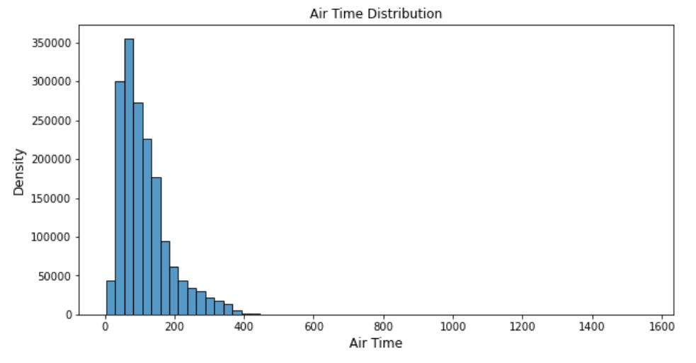
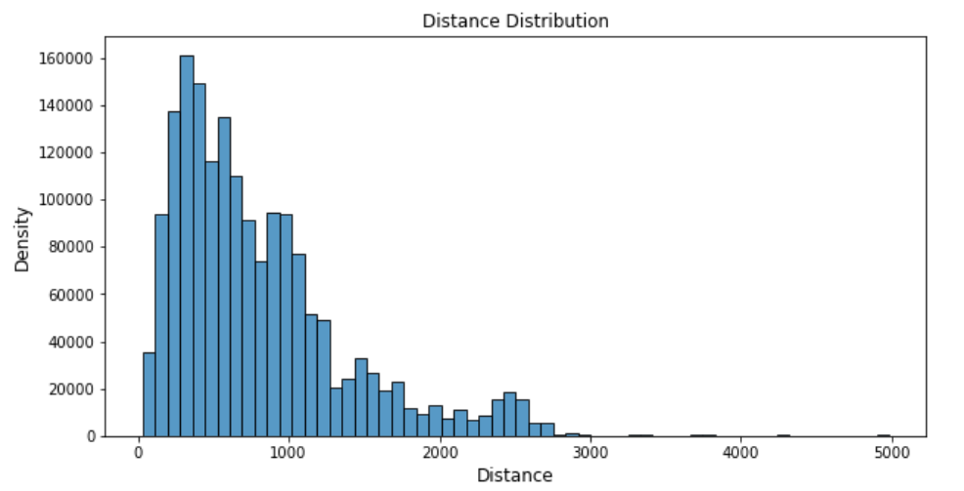
Data exploration - Findings
Airports Chicago Midaway, Newark have more % delayed flights when compared to Minneapolis, Atlanta which have least % delayed flights. Origin can be considered as an impotant feature

Slide 9
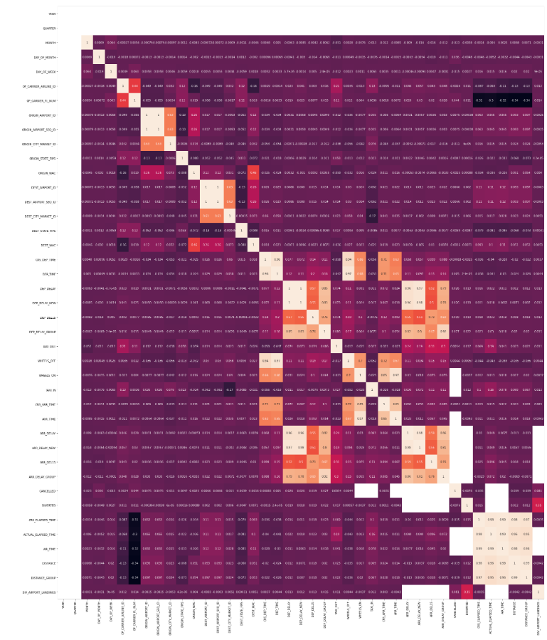
DATA EXPLORATION - FINDINGS
2
+
Correlation Matrix:
Few features seems to correlate especially ones in lighter shades
Deleted features with high correlation
['ORIGIN_AIRPORT_SEQ_ID', 'DEST_AIRPORT_SEQ_ID', 'DEP_TIME', 'DEP_DELAY_NEW', 'DEP_DELAY_GROUP', 'WHEELS_OFF', 'CRS_ARR_TIME', 'ARR_TIME', 'ARR_DELAY', 'ARR_DELAY_NEW', 'ARR_DELAY_GROUP', 'ACTUAL_ELAPSED_TIME', 'AIR_TIME', 'DISTANCE', 'DISTANCE_GROUP']
For modelling 41 independent variables were selected

Slide 10
Feature Engineering
Is there any impact due to flight delays? Flight delays not only cause inconvenience to passengers, but also cost the carriers billions of dollars. Flight delays can be caused due to bad weather conditions, airport congestion, airspace congestion, maintenance or security issues. These delays tarnish airlines on-time reputation, often resulting in loss of demand by passengers.
Looking at statistics compiled by the Bureau of Transport Statistics, the extreme weather causes only 5% delay of total delay minutes whereas the biggest contributors to delay have consistently been late arrival of aircraft and air carrier delay. In the light of the above statistics there is a need for an intelligent and automated prediction system that can predict possible airline delays. If we can model these delays accurately, we can account for most of the delayed flights per year.
Prior Flight Information
In order to predict whether a flight will be delayed or not, any future information about the flight like actual arrival time, air time cannot be used. But we can retrieve any past history of the flight. Calculating number of trips for each TAIL_NUM for each day, and retrieving the prior origin airport and prior departure hour from previous flight and if flight was delayed.
Cyclical Features
Hours of a day, Days of week, months in a year are some examples of cyclical features. Converting these raw features into cyclical features (0 - 24 hour). Each cyclical feature can be converted to the sin and cos components of the feature as (x, y) coordinates of a circle. The other benefit of the transformation is to see the correlation of the cyclical features to target data.
Categorical Features
Converting categorical features into numbers using Label Encoder.
'TAIL_NUM', 'OP_UNIQUE_CARRIER', 'ORIGIN_CITY_NAME', 'ORIGIN_STATE_NM', 'DEST_CITY_NAME', 'DEST_STATE_NM', 'PRIOR_ORIGIN_CITY_NAME'

Slide 11
Features with highest correlation to Target Variable
Finding out features with highest correlation to Target Variable using df.corr(). Features with the highest correlation to Target Variable: Prior delay, prior departure delay, hour of the day.
We can later compare these features to the features with highest feature importance obtained from best model.

Slide 12
Data Modeling – Hyper parameter tuning using DASk
Is there any impact due to flight delays? Flight delays not only cause inconvenience to passengers, but also cost the carriers billions of dollars. Flight delays can be caused due to bad weather conditions, airport congestion, airspace congestion, maintenance or security issues. These delays tarnish airlines on-time reputation, often resulting in loss of demand by passengers.
Looking at statistics compiled by the Bureau of Transport Statistics, the extreme weather causes only 5% delay of total delay minutes whereas the biggest contributors to delay have consistently been late arrival of aircraft and air carrier delay. In the light of the above statistics there is a need for an intelligent and automated prediction system that can predict possible airline delays. If we can model these delays accurately, we can account for most of the delayed flights per year.
Hyper parameter Tuning using DASK
Dask is a ‘parallel computing’ python library that has been designed to run across multiple systems. Dask can efficiently perform parallel computations on a single machine using multi-core CPUs. In order to use lesser memory during computations, Dask stores the complete data on the disk, and uses chunks of data (smaller parts, rather than the whole data) from the disk for processing. Dask supports the Pandas dataframe and Numpy array data structures to analyze large datasets.
Dask Dataframe: Dask dataframe consists of multiple smaller pandas dataframes.
Dask-ml: Dask ML provides scalable machine learning algorithms in python which are compatible with scikit-learn.
Joblib: A user can perform parallel computing using scikit-learn (on a single machine) by setting the parameter njobs = -1. Scikit-learn uses Joblib to perform these parallel computations. Joblib is a library in python that provides support for parallelization
Dask-Search CV: Parallel to Gridsearch CV in sklearn, Dask provides a library called Dask-search CV (Dask-search CV is now included in Dask ML). It merges steps so that there are less repetitions.
Note: The dataset is imbalanced with 18% flights Delayed and 82% fights On-Time.

Slide 13
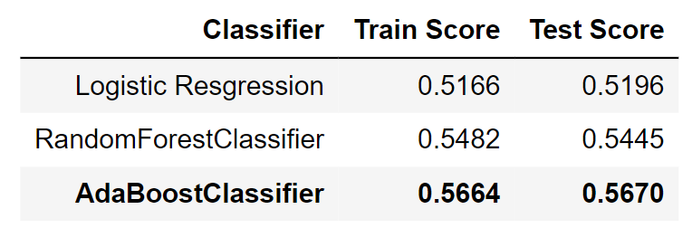
Data modeling
Is there any impact due to flight delays? Flight delays not only cause inconvenience to passengers, but also cost the carriers billions of dollars. Flight delays can be caused due to bad weather conditions, airport congestion, airspace congestion, maintenance or security issues. These delays tarnish airlines on-time reputation, often resulting in loss of demand by passengers.
Looking at statistics compiled by the Bureau of Transport Statistics, the extreme weather causes only 5% delay of total delay minutes whereas the biggest contributors to delay have consistently been late arrival of aircraft and air carrier delay. In the light of the above statistics there is a need for an intelligent and automated prediction system that can predict possible airline delays. If we can model these delays accurately, we can account for most of the delayed flights per year.
ML pipeline using PCA, dimensionality reduction technique to reduce the dimensions of feature space and GridSearchCV parameters for Logistic Regression, Random Forest and Ada Boost Classifiers
MODEL PERFORMANCE – Average Precision Score

Slide 14
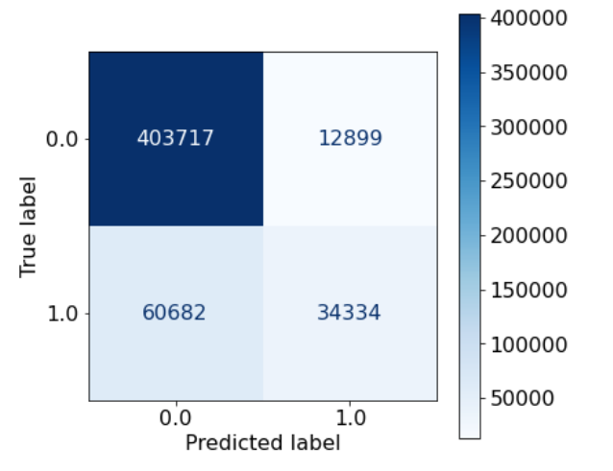
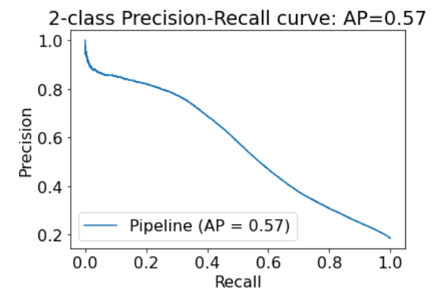
Data modeling
Is there any impact due to flight delays? Flight delays not only cause inconvenience to passengers, but also cost the carriers billions of dollars. Flight delays can be caused due to bad weather conditions, airport congestion, airspace congestion, maintenance or security issues. These delays tarnish airlines on-time reputation, often resulting in loss of demand by passengers.
Looking at statistics compiled by the Bureau of Transport Statistics, the extreme weather causes only 5% delay of total delay minutes whereas the biggest contributors to delay have consistently been late arrival of aircraft and air carrier delay. In the light of the above statistics there is a need for an intelligent and automated prediction system that can predict possible airline delays. If we can model these delays accurately, we can account for most of the delayed flights per year.
CONFUSION MATRIX
PRECISION-RECALL CURVE

Slide 15
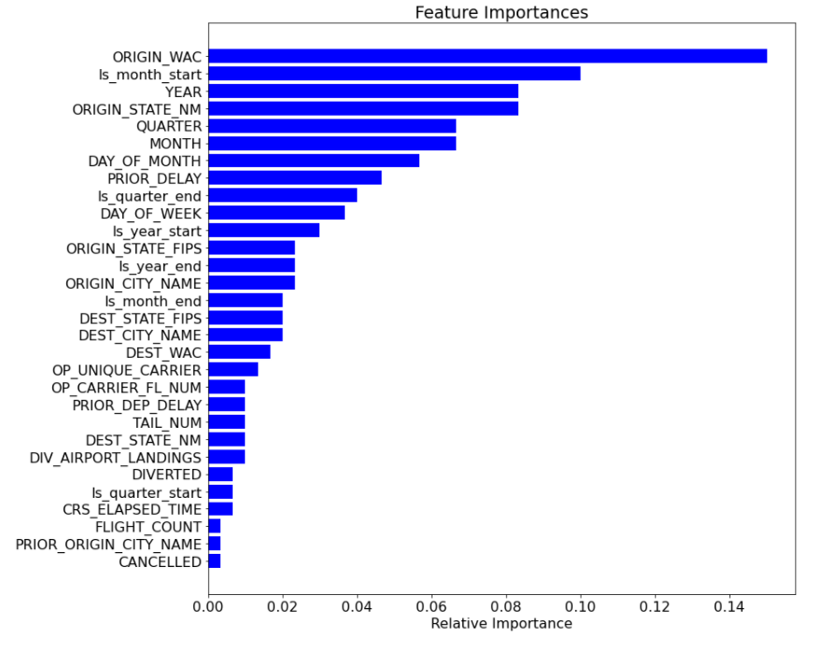
Data modeling – Feature importance
Is there any impact due to flight delays? Flight delays not only cause inconvenience to passengers, but also cost the carriers billions of dollars. Flight delays can be caused due to bad weather conditions, airport congestion, airspace congestion, maintenance or security issues. These delays tarnish airlines on-time reputation, often resulting in loss of demand by passengers.
Looking at statistics compiled by the Bureau of Transport Statistics, the extreme weather causes only 5% delay of total delay minutes whereas the biggest contributors to delay have consistently been late arrival of aircraft and air carrier delay. In the light of the above statistics there is a need for an intelligent and automated prediction system that can predict possible airline delays. If we can model these delays accurately, we can account for most of the delayed flights per year.

Slide 16

CONCLUSIONS & NEXT STEPS
2
+
The dataset used for the project contains local flight data for the months January, February and March for the year 2019, does not take into considerations any weather conditions or natural calamities into account.
we plan to identify the significance of each feature by using stats models. Also, according to the Federal Aviation Administration, most of the delays in winter are due to surface winds, low ceiling and low visibility, whereas during summer the majority of delays is attributable to convective weather, low ceiling and associated low visibility (Federal Aviation Administration, 2017). It will be wise to include daily weather data, like wind, speed and precipitation rate, for each origin and destination location for each flight.

Slide 17

THANK YOU
2
+

